Slide 1

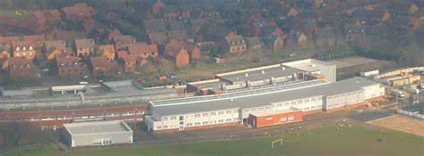
YEAR 9 INFORMATION EVENING
Parents supporting Learning
An Introduction to Year 9
September 2026

Slide 2


Slide 3

Our Curriculum
We care deeply about ensuring that all students experience a vibrant and fulfilling education which supports them in developing both their individual qualities and academic qualifications. We believe this can only be achieved through a student-centred culture which is dynamic, challenging and affirming.

Slide 4
Year 9 Curriculum
English (Language and Literature) 9 sessions per fortnight
Maths 7 sessions per fortnight
PE (Option to study towards a Level 2 Sports Leadership)​ 5 sessions per fortnight
Combined Science (trilogy) 8 sessions | Triple Science 14 sessions
GCSE Preference A 6 sessions
GCSE Preference B 6 sessions
GCSE Preference C 6 sessions | Triple Science (with combined Science) 14 sessions
RE (non-examined) 1 session per fortnight
Life Skills (non-examined) 2 sessions per fortnight
Any changes to preference subjects to made by Friday 23 October.

Slide 5
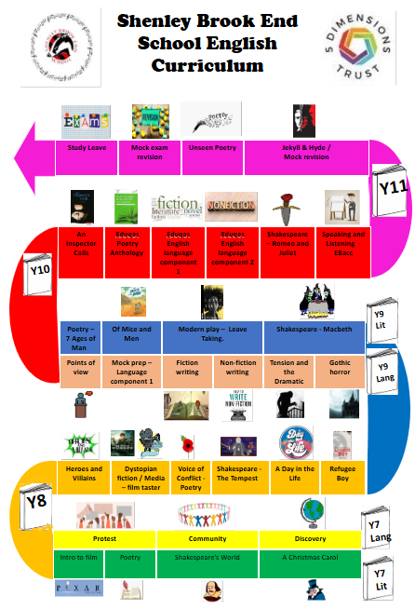
A Curriculum Journey

Slide 6
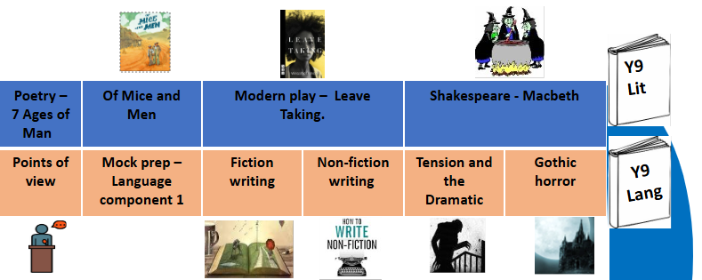

Slide 7
​ Attitudes to Learning in School​
Title​ | Descriptor ​​
Exceeding Shenley Values ​​ | Exemplifies kindness, respect and hard work in lessons. ​​
Meeting Shenley Values ​​ | Always demonstrates they are kind, work hard and are respectful in lessons.​​
Working Towards Meeting Shenley Values ​​ | Mostly demonstrates they are kind, work hard and are respectful in lessons. ​​
Not Meeting Shenley Values ​​ | Sometimes demonstrates they are kind, work hard and are respectful in lessons. ​​
Notes:
CWR

Slide 8
Attitudes to Home Learning​​
Title​​ | Descriptor ​​​
Exceeding Home Learning Expectations ​​​ | Always completes homework on time. Homework is of an exemplary standard. ​​​
Meeting Home Learning Expectations ​​​ | Always completes homework on time. Homework is generally of a good standard. ​​​
Moving Towards Meeting Home Learning Expectations ​​​ | Sometimes completes homework on time. Homework is of a variable standard for ability. ​​​
Not Meeting Home Learning Expectations ​​​ | Homework is rarely or never completed. ​​​

Slide 9



Home Learning
All students are expected to do homework to develop their skills and knowledge at home independently. Homework may be to prepare for a lesson, to consolidate learning already happened in class or to collect sources. Not all homework is written; it may involve reading, watching a TV programme, individual research or revision, making a model or attending an extra-curricular club.
Notes:
UPDATE – Share TEAMS - SPARX

Slide 10
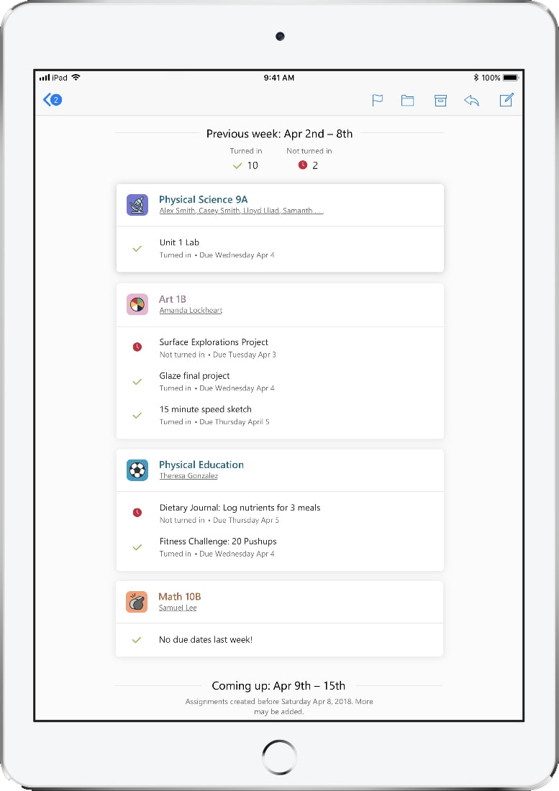
MS Teams, Sparx and Seneca
Your child will have a Team page for every subject.
Your child can contact their teachers through Teams.
Homework will be set on Teams.
Sparx English and Sparx Maths will be emailed separately.
You will receive a weekly update on their assignments (homework), when they are due, if they have been submitted and if they have been returned for further work.
You may receive a further email from Seneca, although this will be posted on Teams.

Slide 11
“Old” GCSEs “New” GCSEs
Reporting
Throughout KS4 we will be using GCSE grades or Level 2 equivalents to report progress to you.
Students will have:
WAG (working at grade)
FOG (forecast grade)
These will be reported from PR2 onwards (10 June)
A breakdown of assessments can be viewed throughout the year on Go4Schools
A*
A
B
C
D
E
F
G
9
8
7
6
5
4
3
2
1

Slide 12
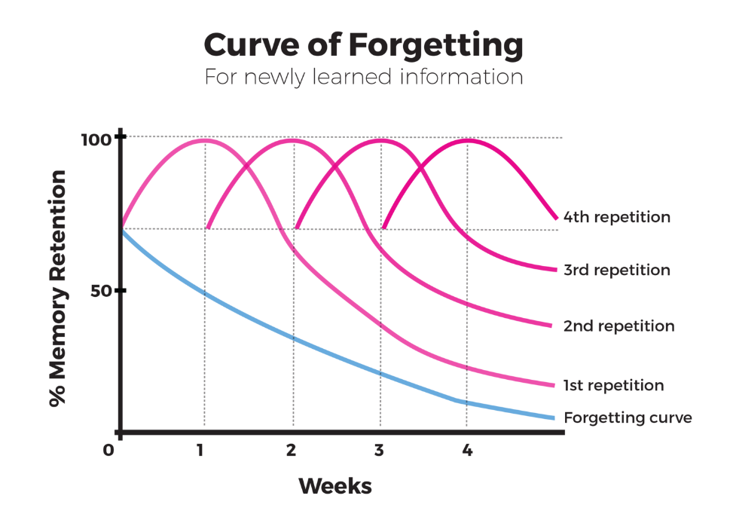
Why is revision important?
The graph shows why revision is important.
Building a habit of revisiting old learning is important in Year 9 as the Year 9 curriculum won’t be formally assessed until the end of Year 11.
That’s a long time to forget all that knowledge in!

Slide 13
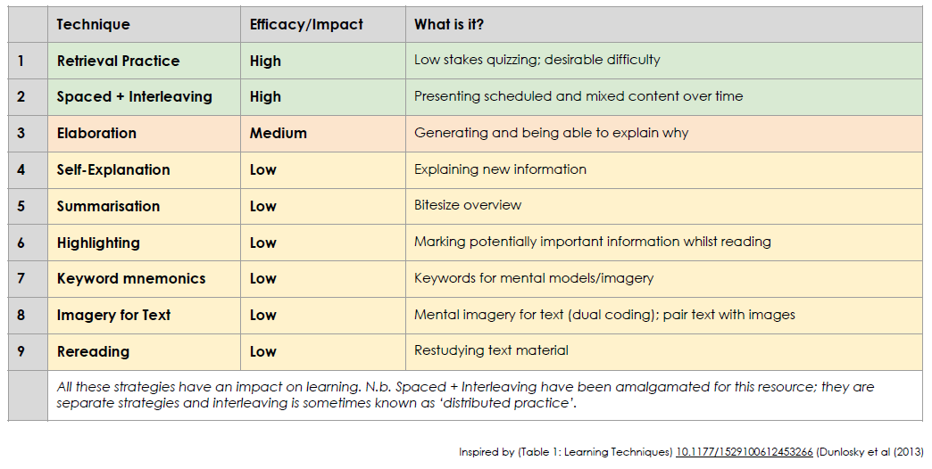
What can I do to help my child revise?
Purchase revision guides – Y9 parents will be able to purchase revision guides from w/c 2 November and then on a rolling program.
Use programmes like BBC Bitesize and Seneca to ‘revisit’ learning.
Quiz your child! Test their memory!
Keep revision active.

Slide 14






Slide 15

Core Learning – 80% of attitude to learning need to be at Meeting or Exceeding Shenley Expectations​.
Project Based Learning – 1 Ambition Project completed as part of the form time program and through TEAMs. Presentations will be voice recorded and presented to form groups.

Slide 16

Personal Development
Physical Health and Wellbeing
Careers and Skills Development
Contribution and Community
Creative and Cultural

Slide 17
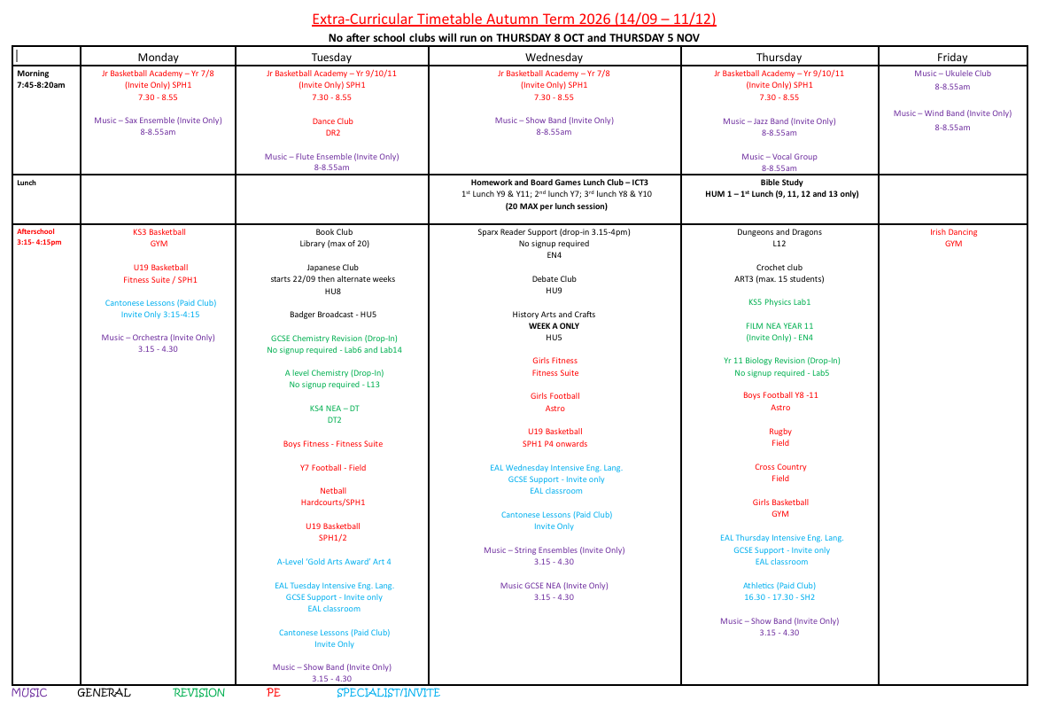
Extra Curricular Clubs
Notes:
EPE

Slide 18
Negative Points (N Codes)
N1 | Usually a verbal warning, 1 negative mark on Arbor, discussion with the member of staff.
N2 | Not following instructions or another warning will result in a lesson removal a same day after school reflection. 2 Negative points on Arbor.
X1 | X1 – Extreme behaviour – your child's year leader, pastoral leader or a member of SLT will contact you and may be that an issue is being investigated.

Slide 19
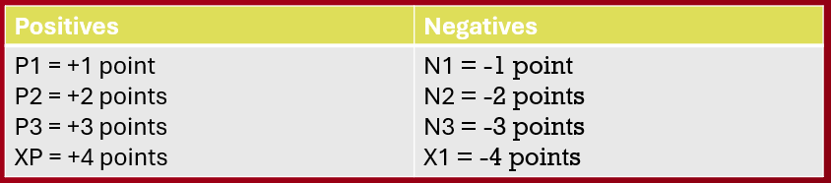
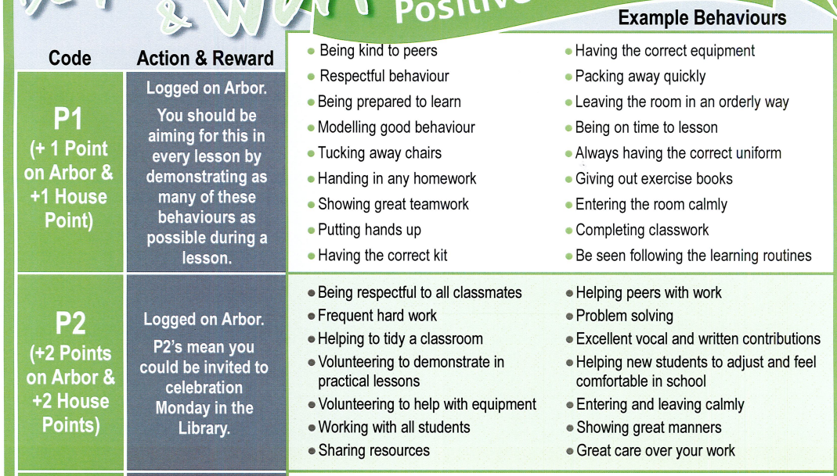
Positive Points and Behaviour Points
Notes:
MBA – UPDATE TO POSTERS

Slide 20
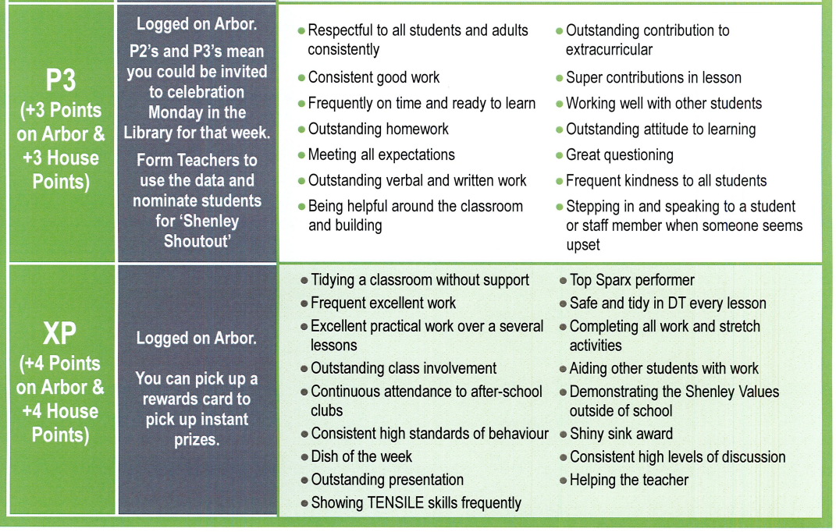

Slide 21
Termly Lottery
Students in the top 50 Positive Points
All students whose attitudes are 80% or over across all subjects
Students with 0 negative points
End of year only – all students with 100% attendance
Termly Activities
Autumn Term | Spring Term | Summer Term
In House Rocking Reindeer | In-House Cinema | Inflatables Day Theme Park (for following September)
Additional Rewards
Leadership Breakfasts
Celebration Friday
XP Prizes – E.g. Amazon Vouchers, Skip the Queue Passes, Stationary
Notes:
EPE

Slide 22

Support Structure
Form Tutor
We want our students to be at the centre and have the support and guidance of staff and peers to achieve
Parents
Peers
student
STUDENT
EAL
Subject
Teachers
Extended
Learning
Progress Leaders
and Year Leaders
Student
Services

Slide 23



Slide 24
Year 9 Calendar
Meet the Tutor Evening - 5 November
Progress Check 1 – 17 December
1:1 Tutor Pathway Meetings – 1 – 12 February
Year 9 Mocks – w/c 3 May
Progress Check 2 – 10 June
Parents’ Evening – 24 June

