Slide 1

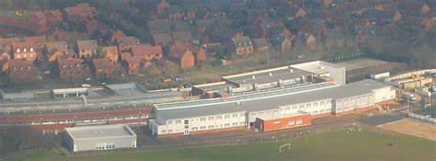
YEAR 7 INFORMATION EVENING
Parents Supporting Learning
An Introduction to Year 7
September 2026

Slide 2

Notes:
CWR

Slide 3
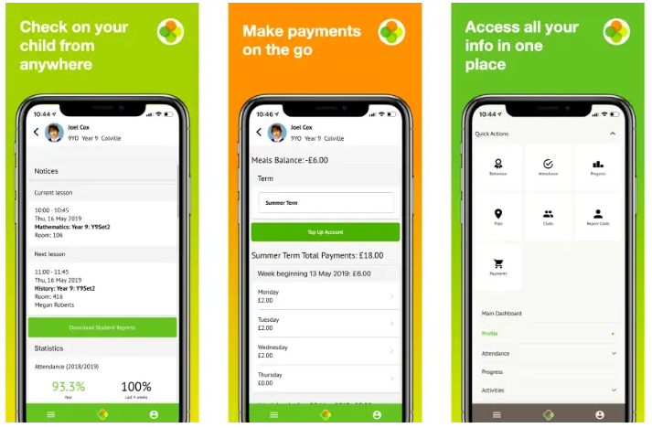
Notes:
EPE

Slide 4
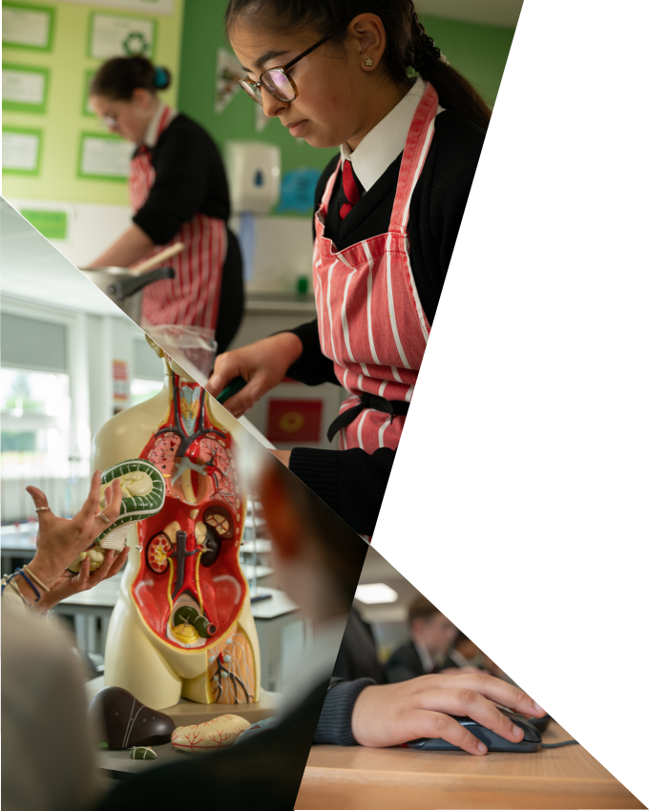
Our Curriculum
We care deeply about ensuring that all students experience a vibrant and fulfilling education which supports them in developing both their individual qualities and academic qualifications. We believe this can only be achieved through a student-centred culture which is dynamic, challenging and affirming.
Notes:
CWR

Slide 5
Year 7 Curriculum
Your child follows a 2-week timetable, with a mixture of sets and in their form group.
Set Classes
English (7 lessons a fortnight, mixed ability)
Maths (7 lessons a fortnight, ability set)
Languages (4 lessons a fortnight, mixed ability)
DT (2 lessons a fortnight, mixed ability, on a rotation of subjects)
PE (4 lessons a fortnight, ability set after half term)
Form Group Classes
Art (3 lessons a fortnight) | History (3 lessons a fortnight) | Music (3 lessons a fortnight)
Drama (3 lessons a fortnight) | ICT (3 lessons a fortnight) | RE (2 lessons a fortnight)
Geography (3 lessons a fortnight) | Lifeskills (2 lessons a fortnight) | Science (4 lessons a fortnight)
Notes:
CWR

Slide 6
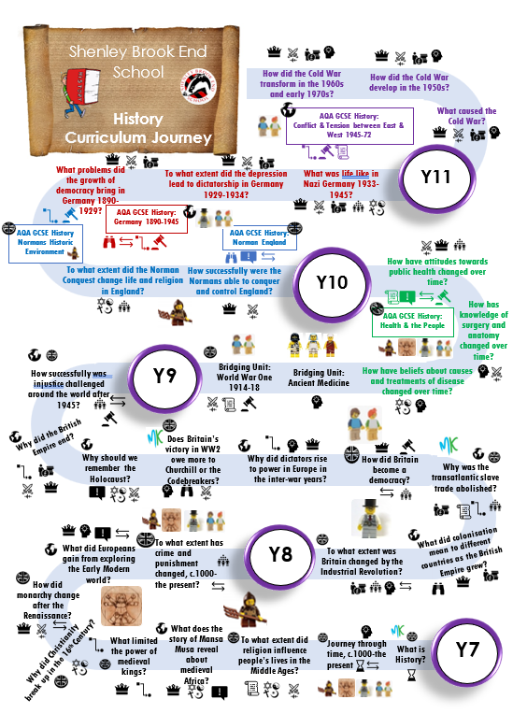
A Curriculum Journey
These can be found for all subjects on the school website
Notes:
CWR

Slide 7
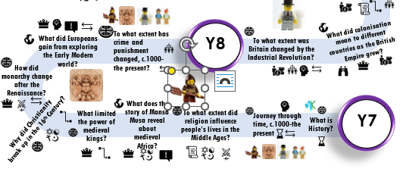
Notes:
CWR

Slide 8
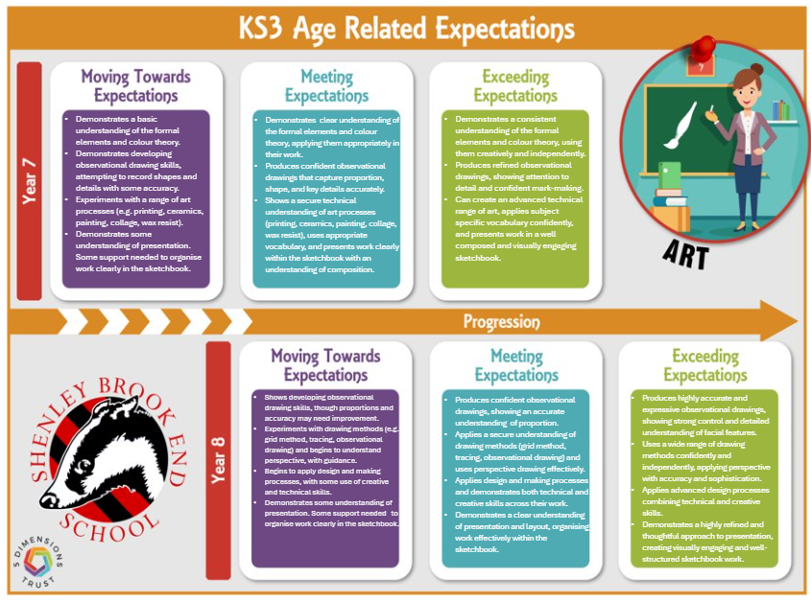
Notes:
CWR

Slide 9
​ Attitudes to Learning in School​
Title​ | Descriptor ​​
Exceeding Shenley Values ​​ | Exemplifies kindness, respect and hard work in lessons. ​​
Meeting Shenley Values ​​ | Always demonstrates they are kind, work hard and are respectful in lessons.​​
Working Towards Meeting Shenley Values ​​ | Mostly demonstrates they are kind, work hard and are respectful in lessons. ​​
Not Meeting Shenley Values ​​ | Sometimes demonstrates they are kind, work hard and are respectful in lessons. ​​
Notes:
CWR

Slide 10
Attitudes to Home Learning​
Title​ | Descriptor ​​
Exceeding Home Learning Expectations ​​ | Always completes homework on time. Homework is of an exemplary standard. ​​
Meeting Home Learning Expectations ​​ | Always completes homework on time. Homework is generally of a good standard. ​​
Moving Towards Meeting Home Learning Expectations ​​ | Sometimes completes homework on time. Homework is of a variable standard for ability. ​​
Not Meeting Home Learning Expectations ​​ | Homework is rarely or never completed. ​​
Notes:
CWR

Slide 11



Home Learning
All students are expected to do homework to develop their skills and knowledge at home independently. Homework may be to prepare for a lesson, to consolidate learning already happened in class or to collect sources. Not all homework is written; it may involve reading, watching a TV programme, individual research or revision, making a model or attending an extra-curricular club.
Notes:
CWR

Slide 12
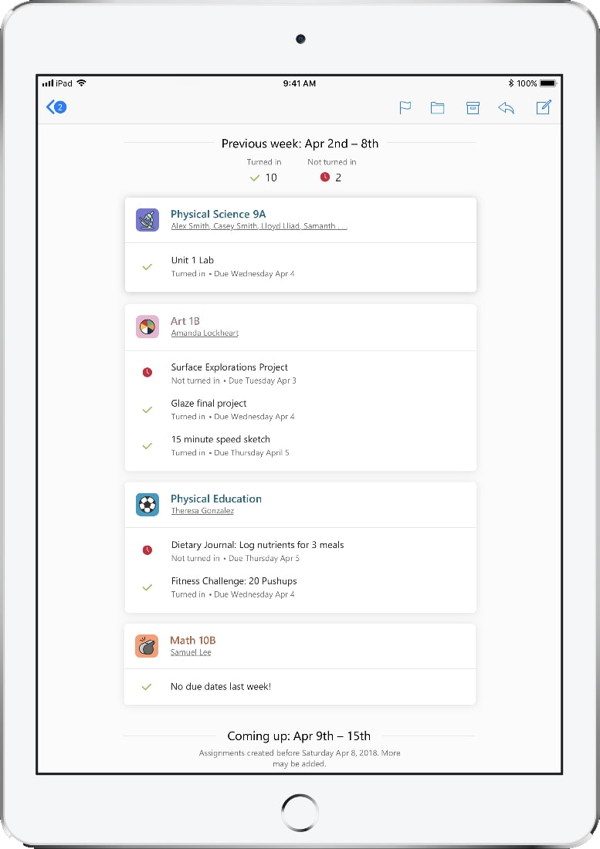
Microsoft Teams
Your child will have a Team page for every subject.
Your child can contact their teachers through Teams and look at class resources.
Homework will be set on Teams.
You will receive a weekly update on their assignments (homework), when they are due, if they have been submitted and if they have been returned for further work.
Notes:
CWR

Slide 13





Notes:
LPE

Slide 14


Slide 15
Core Learning – 80% of attitudes to learning need to be at Meeting or Exceeding Shenley Expectations.
Project Based Learning – 3 Ambition Projects completed as part of the tutor program throughout the year and presented in school.
1st Ambition Project is All About Me!
Notes:
EPE

Slide 16
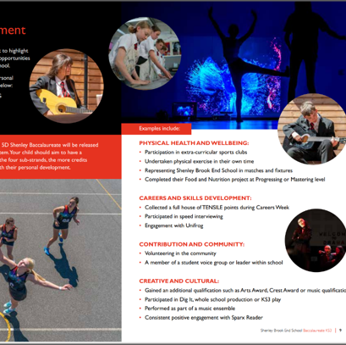
Personal Development
Physical Health and Wellbeing
Careers and Skills Development
Contribution and Community
Creative and Cultural
Notes:
EPE

Slide 17
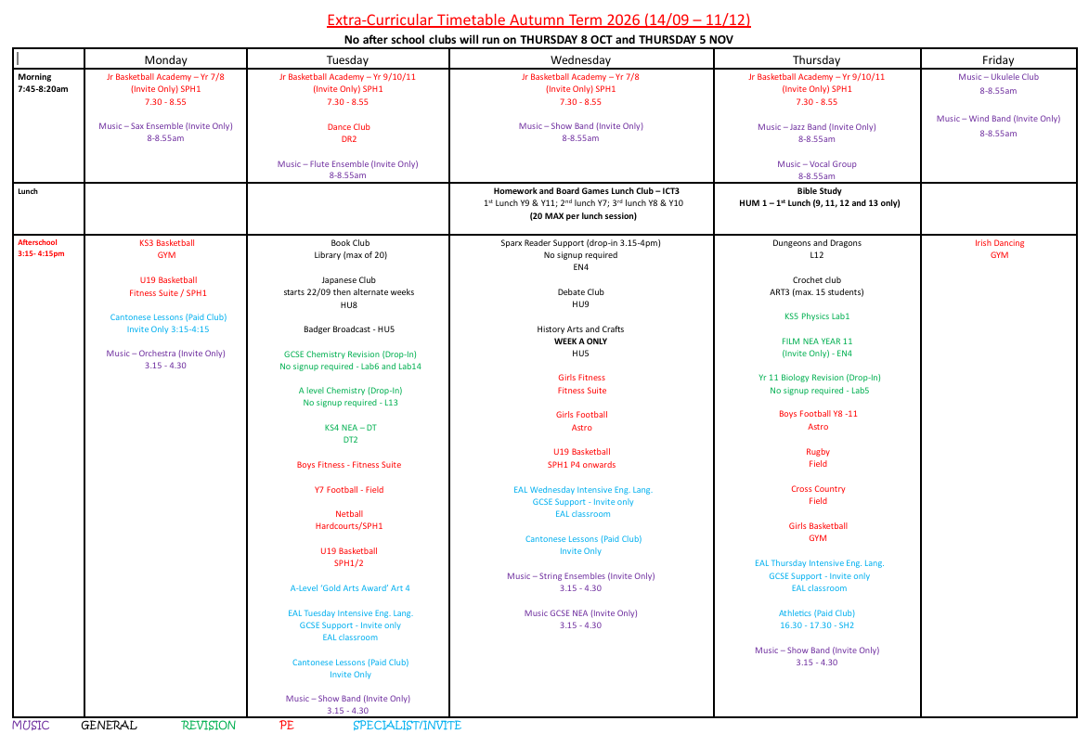
Extra Curricular Clubs
Notes:
EPE

Slide 18
Negative Points (N Codes)
N1 | Usually a verbal warning, 1 negative mark on Arbor, discussion with the member of staff.
N2 | Not following instructions or another warning will result in a lesson removal a same day after school reflection. 2 Negative points on Arbor.
X1 | X1 – Extreme behaviour – your child's year leader, pastoral leader or a member of SLT will contact you and may be that an issue is being investigated.

Slide 19
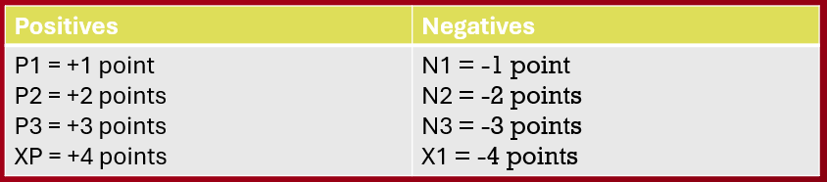
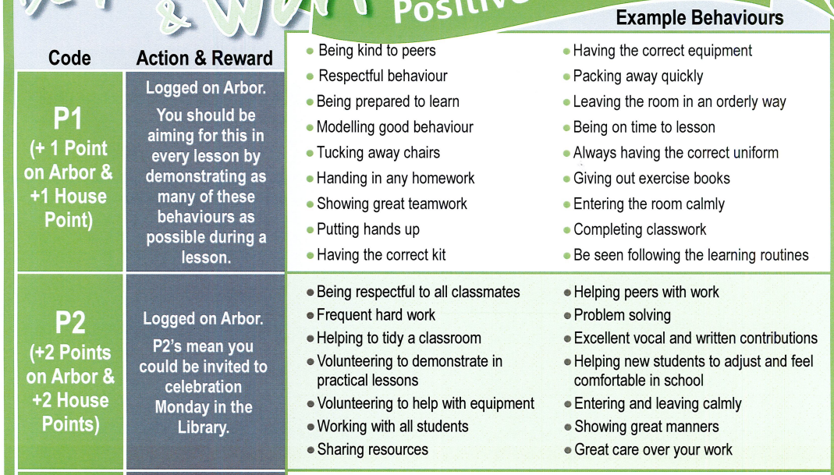
Positive Points and Behaviour Points
Notes:
EPE

Slide 20
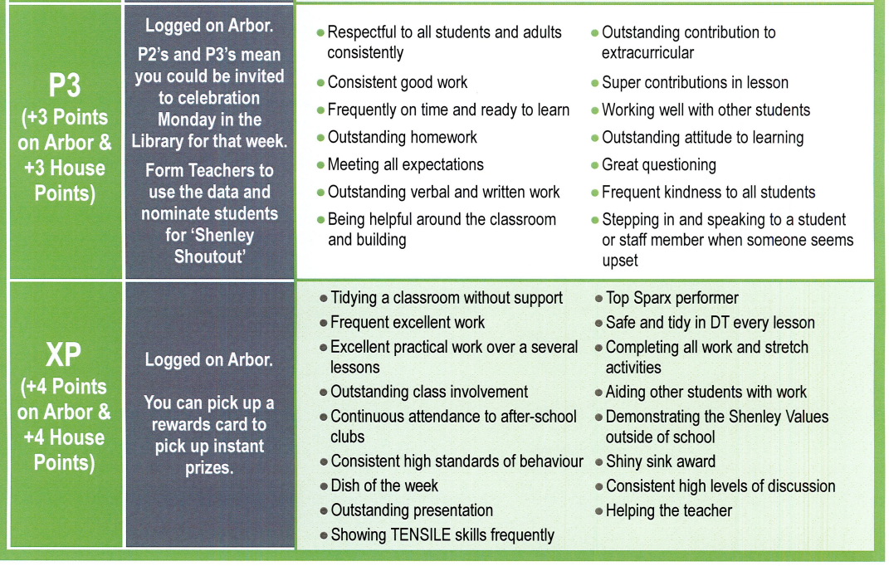
Notes:
EPE

Slide 21
Termly Lottery
Students in the top 50 Positive Points
All students whose attitudes are 80% or over across all subjects
Students with 0 negative points
End of year only – all students with 100% attendance
Termly Activities
Autumn Term | Spring Term | Summer Term
In House Rocking Reindeer | In-House Cinema | Inflatables Day Theme Park (for following September)
Additional Rewards
Leadership Breakfasts
Celebration Friday
XP Prizes – E.g. Amazon Vouchers, Skip the Queue Passes, Stationary
Notes:
EPE

Slide 22
Reminders
Form tutor = first point of contact
Free School Meals (FSM) - need to apply if feel it is applicable. Does not automatically carry on from primary
Students will still be finding their way – students will not be marked late before 21 September
Uniform – if it is not correct please communicate with us or uniform marks will be issued
Year 7 have their own lunchtime and own toilets every break and every lunch
Notes:
MBO - ROUTINES AND UNIFORM - CANTEEN/FOOD QUERIES

Slide 23
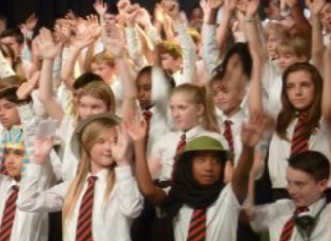

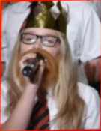
Dig It!
22 October 2026
Dig It auditions are on Thursday 17th September 3.10-4.30 in Music 2.
This is for main character parts and narrator. Students can still be part of the show as a group singer without auditioning.

Slide 24
Year 7 Calendar
Year 7 Anti-Bullying Conference – 19 October
Dig-It performance – 22 October
Meet the Tutor Evening – 5 November
Progress Report 1 – 19 November
Year 7 Speed Interviewing – 18 May
Progress Report 2 – 27 May
Parents’ Evening – 10 June
Holistic Reports Issued – 10 July
Notes:
CWR TO UPDATE Mia to wrap up…..

