Slide 1
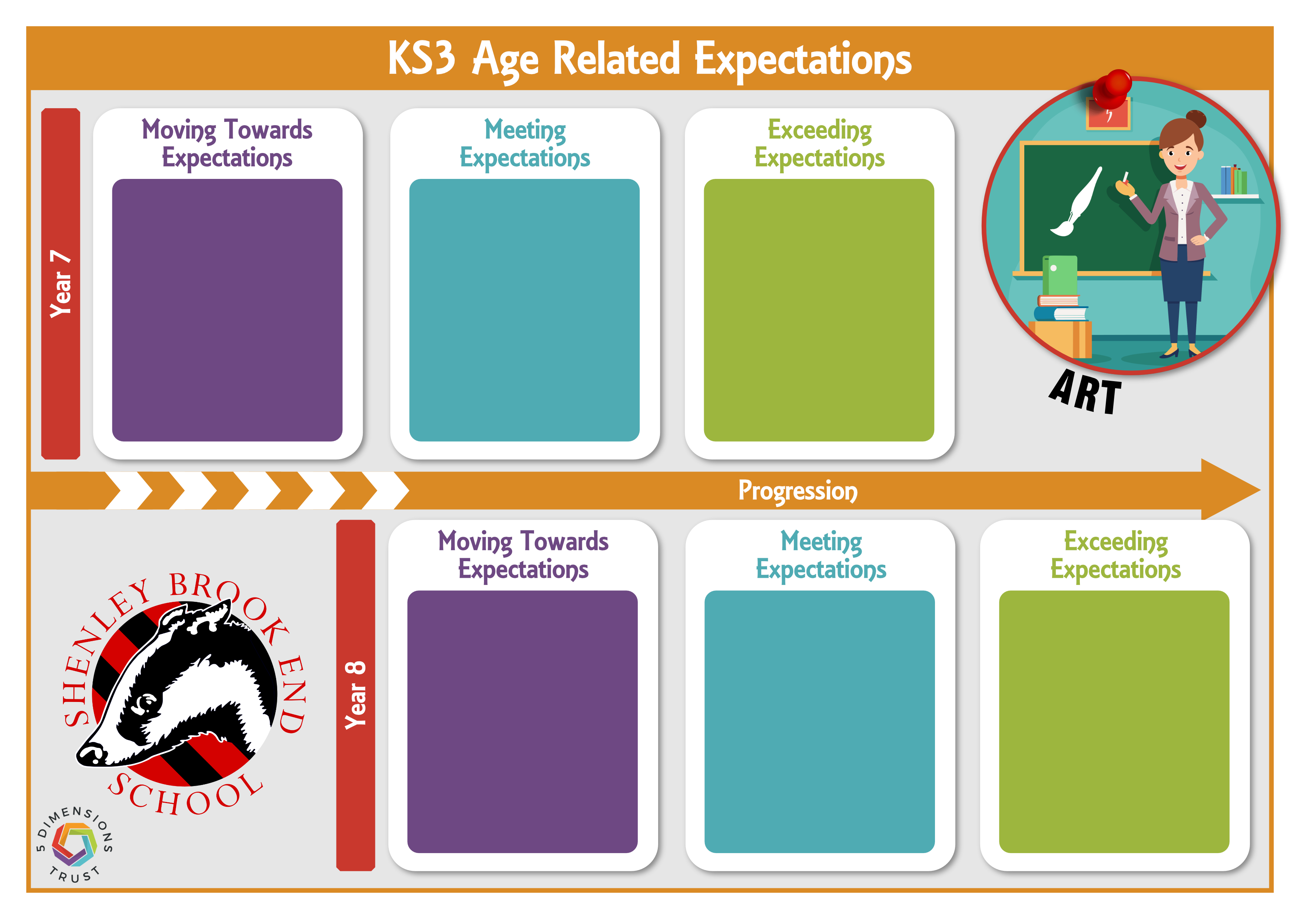
Demonstrates a basic understanding of the formal elements and colour theory.
Demonstrates developing observational drawing skills, attempting to record shapes and details with some accuracy.
Experiments with a range of art processes (e.g. printing, ceramics, painting, collage, wax resist).
Demonstrates some understanding of presentation. Some support needed to organise work clearly in the sketchbook.
Demonstrates clear understanding of the formal elements and colour theory, applying them appropriately in their work.
Produces confident observational drawings that capture proportion, shape, and key details accurately.
Shows a secure technical understanding of art processes (printing, ceramics, painting, collage, wax resist), uses appropriate vocabulary, and presents work clearly within the sketchbook with an understanding of composition.
Demonstrates a consistent understanding of the formal elements and colour theory, using them creatively and independently.
Produces refined observational drawings, showing attention to detail and confident mark-making.
Can create an advanced technical range of art, applies subject specific vocabulary confidently, and presents work in a well composed and visually engaging sketchbook.
Shows developing observational drawing skills, though proportions and accuracy may need improvement.
Experiments with drawing methods (e.g. grid method, tracing, observational drawing) and begins to understand perspective, with guidance.
Begins to apply design and making processes, with some use of creative and technical skills.
Demonstrates some understanding of presentation. Some support needed to organise work clearly in the sketchbook.
Produces confident observational drawings, showing an accurate understanding of proportion.
Applies a secure understanding of drawing methods (grid method, tracing, observational drawing) and uses perspective drawing effectively.
Applies design and making processes and demonstrates both technical and creative skills across their work.
Demonstrates a clear understanding of presentation and layout, organising work effectively within the sketchbook.
Produces highly accurate and expressive observational drawings, showing strong control and detailed understanding of facial features.
Uses a wide range of drawing methods confidently and independently, applying perspective with accuracy and sophistication.
Applies advanced design processes combining technical and creative skills.
Demonstrates a highly refined and thoughtful approach to presentation, creating visually engaging and well-structured sketchbook work.

